Slide 1
EECS 498 System Design of a Search Engine
Winter 2026
Lecture 12: LinuxTinyServer
Nicole Hamilton
https://web.eecs.umich.edu/~nham/
nham@umich.edu

Slide 2
agenda
details
HTTP redirects
LinuxTinyServer
opening ports to WSL2
bind( ), listen( ) and accept( )
the Talk( ) thread
a plugin interface
forms

Slide 3
agenda
details
HTTP redirects
LinuxTinyServer
opening ports to WSL2
bind( ), listen( ) and accept( )
the Talk( ) thread
a plugin interface
forms

Slide 4
details
none

Slide 5
agenda
details
HTTP redirects
LinuxTinyServer
opening ports to WSL2
bind( ), listen( ) and accept( )
the Talk( ) thread
a plugin interface
forms

Slide 6
What’s going on with this redirect? It’s obviously wrong.
tcsh-1% LinuxGetUrl http://web.eecs.umich.edu/
<!DOCTYPE HTML PUBLIC "-//IETF//DTD HTML 2.0//EN">
<html><head>
<title>301 Moved Permanently</title>
</head><body>
<h1>Moved Permanently</h1>
<p>The document has moved <a href="https://sites.google.com/a/umich.edu/petersonlab/">here</a>.</p>
<hr>
<address>Apache/2.4.58 (Ubuntu) Server at web.eecs.umich.edu Port 80</address>
</body></html>
tcsh-2%

Slide 7

Why does it seem to work if I type it into a browser?

Slide 8
if it works for you
You’re probably using Chrome or Edge which hide the problem.
Chrome always tries the HTTPS version of any URL first.
Edge maintains a curated lists of site likely to support HTTPS and if the domain is on the list, tries HTTPS first.
(Apparently, the thinking is that lots of old links have never been updated, even if the server was.)
So, neither Chrome nor Edge ever notices the faulty redirect.

Slide 9
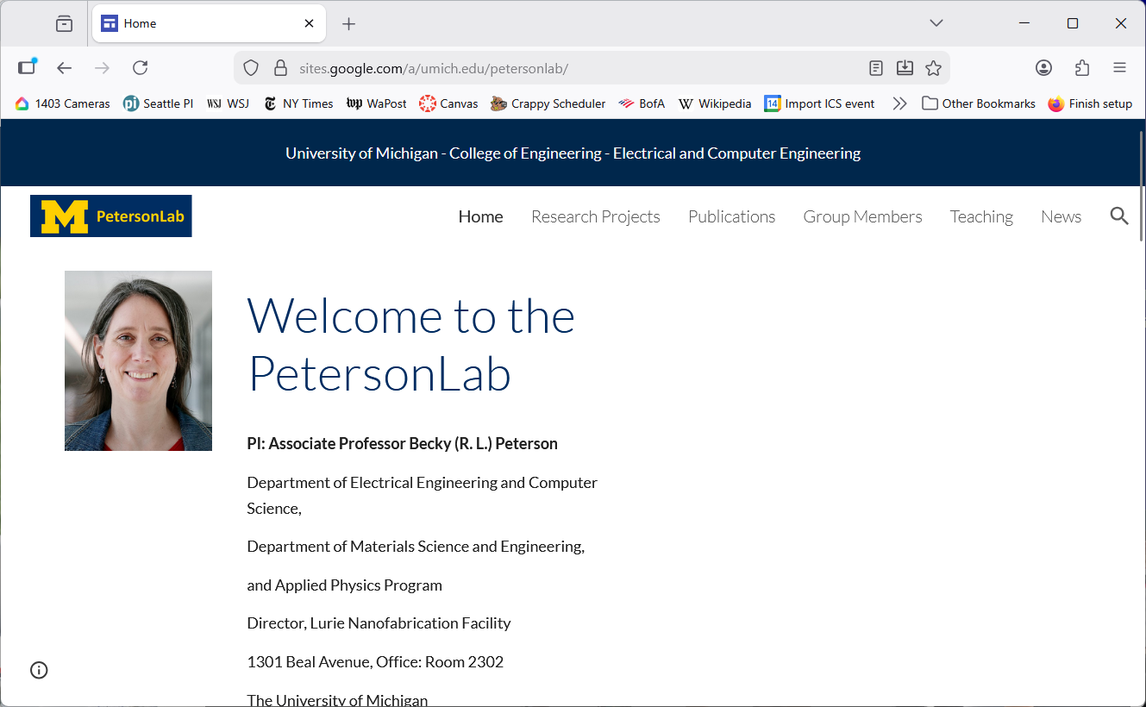
But if you use Firefox, this is what you’d see.

Slide 10
when crawling
You might decide to do what Chrome does, always trying HTTPS first.
If it doesn’t support HTTPS, you might decide to discard the link.

Slide 11
agenda
details
HTTP redirects
LinuxTinyServer
opening a port to WSL2
bind( ), listen( ) and accept( )
the Talk( ) thread
a plugin interface
forms

Slide 12
A simple web server
You need a web server front end for your engine.
Two parts:
The HTTP server.
A plugin that can work with a form.

Slide 13
LinuxTinyServer
A very minimal web server for Linux.
It begins listening on a socket for connection requests from browser.
Each time it gets a request, it creates a thread with a new socket to talk to the client.
If it’s a “magic path”, it can call a plugin module.
Otherwise, it handles GET requests by serving up the specified file if it exists.

Slide 14
LinuxTinyServer takes a port number and a root directory for a website.
tcsh-5% head LinuxTinyServer.cpp
// Linux tiny HTTP server.
// Nicole Hamilton nham@umich.edu
// This variation of LinuxTinyServer supports a simple plugin interface
// to allow "magic paths" to be intercepted. (But the autograder will
// not test this feature.)
// Usage: LinuxTinyServer port rootdirectory
// Compile with g++ -pthread LinuxTinyServer.cpp -o LinuxTinyServer
tcsh-7%

Slide 15
LinuxTinyServer opens a socket and begins listening for connections.
tcsh-6% ./LinuxTinyServer
Usage: ./LinuxTinyServer port rootdirectory
tcsh-7% ls website
Images Styles index.htm
tcsh-8% ./LinuxTinyServer 5000 website
Listening on 0.0.0.0:5000

Slide 16
LinuxTinyServer responds with the requested page.
tcsh-8% ./LinuxTinyServer 5000 website
Listening on 0.0.0.0:5000
Connection accepted from 127.0.0.1:54690
GET /index.htm HTTP/1.1
Host: localhost
User-Agent: LinuxGetUrl/2.0 nham@umich.edu (Linux)
Accept: */*
Accept-Encoding: identity
Connection: close
Requested path = /index.htm
Actual path = website/index.htm
HTTP/1.1 200 OK
Content-Length: 8964
Connection: close
Content-Type: text/html

Slide 17
agenda
details
HTTP redirects
LinuxTinyServer
opening a port to WSL2
bind( ), listen( ) and accept( )
the Talk( ) thread
a plugin interface
forms

Slide 18
opening a port to WSL2
By default, the Windows Defender Firewall blocks most inbound connect requests coming from outside the machine.
Also, ports in WSL2 are virtualized and by default, also cannot be accessed except as localhost.

Slide 19
opening a port to WSL2
Two steps:
Open the port in the Windows Defender Firewall to Windows applications.
Set the networking mode in WSL2 to mirrored, meaning the network interfaces available in Windows are mirrored in WSL2.

Slide 20
opening a port to WSL2
Two steps:
Open the port in the Windows Defender Firewall to Windows applications.
Set the networking mode in WSL2 to mirrored, meaning the network interfaces available in Windows are mirrored in WSL2.

Slide 21
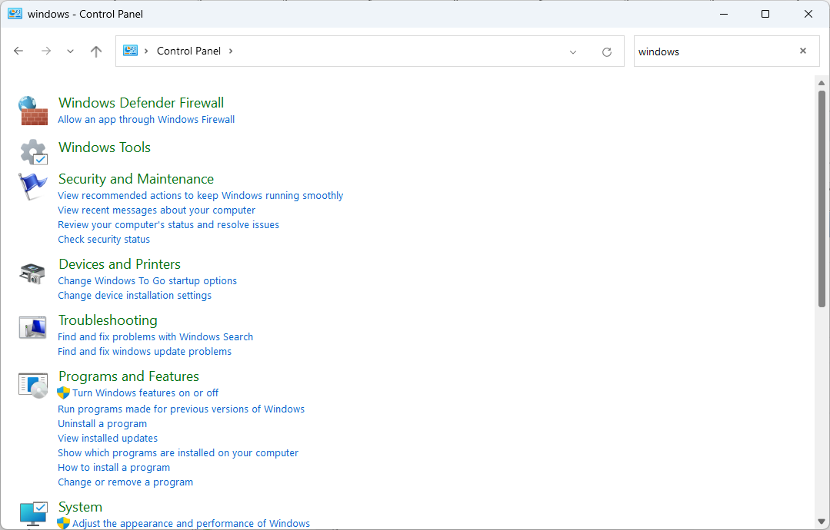
Windows Defender Firewall
1. It’s in the control panel.

Slide 22
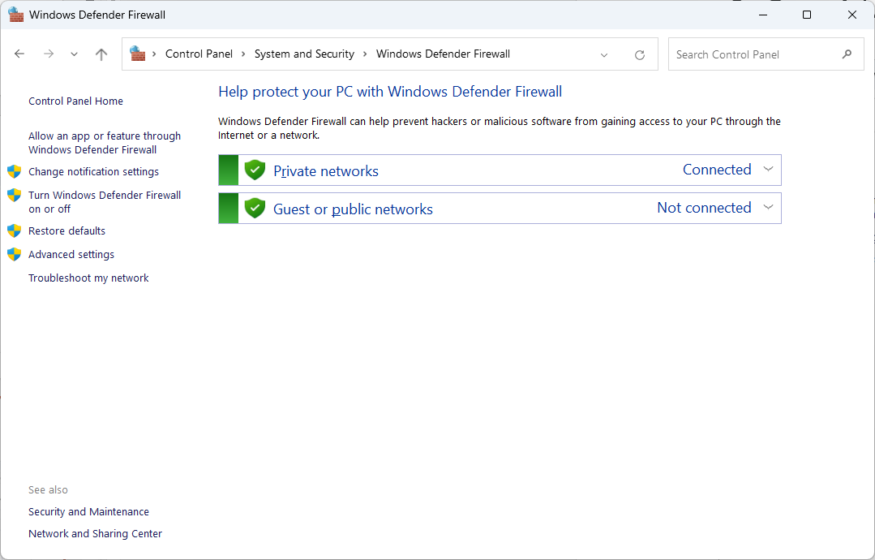
Windows Defender Firewall
2. Go to Advanced Settings.

Slide 23
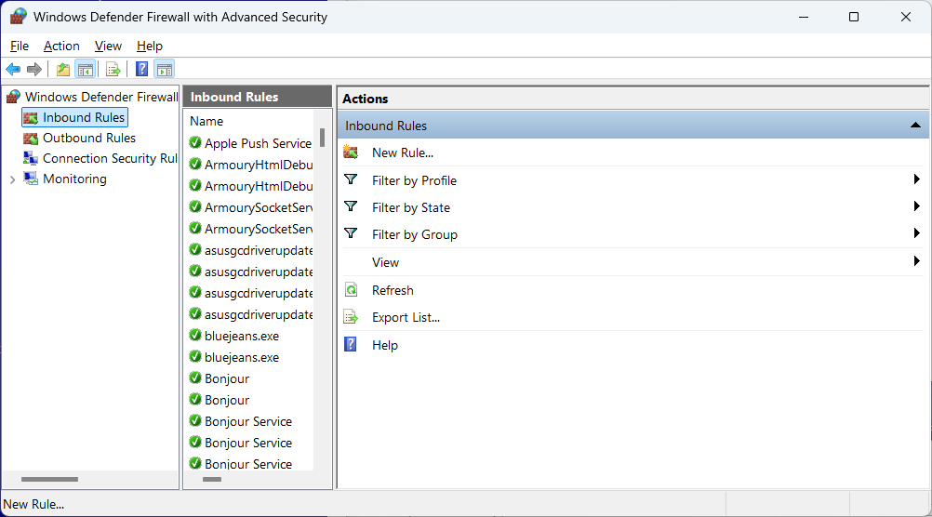
Windows Defender Firewall
3. Create a new rule.

Slide 24
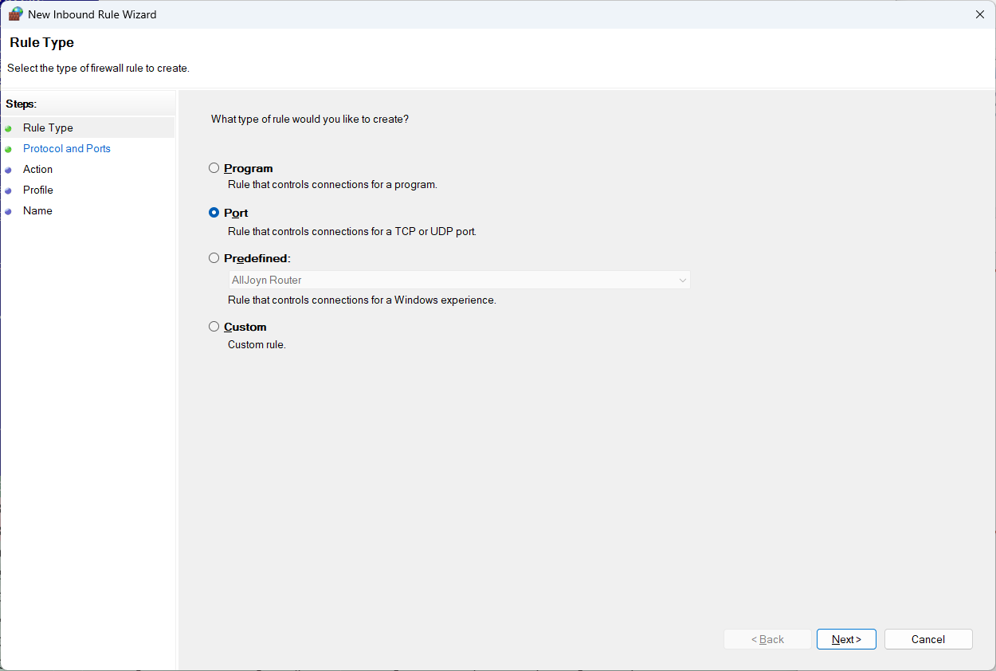
Windows Defender Firewall
4. The new rule will open a port for inbound connections.

Slide 25
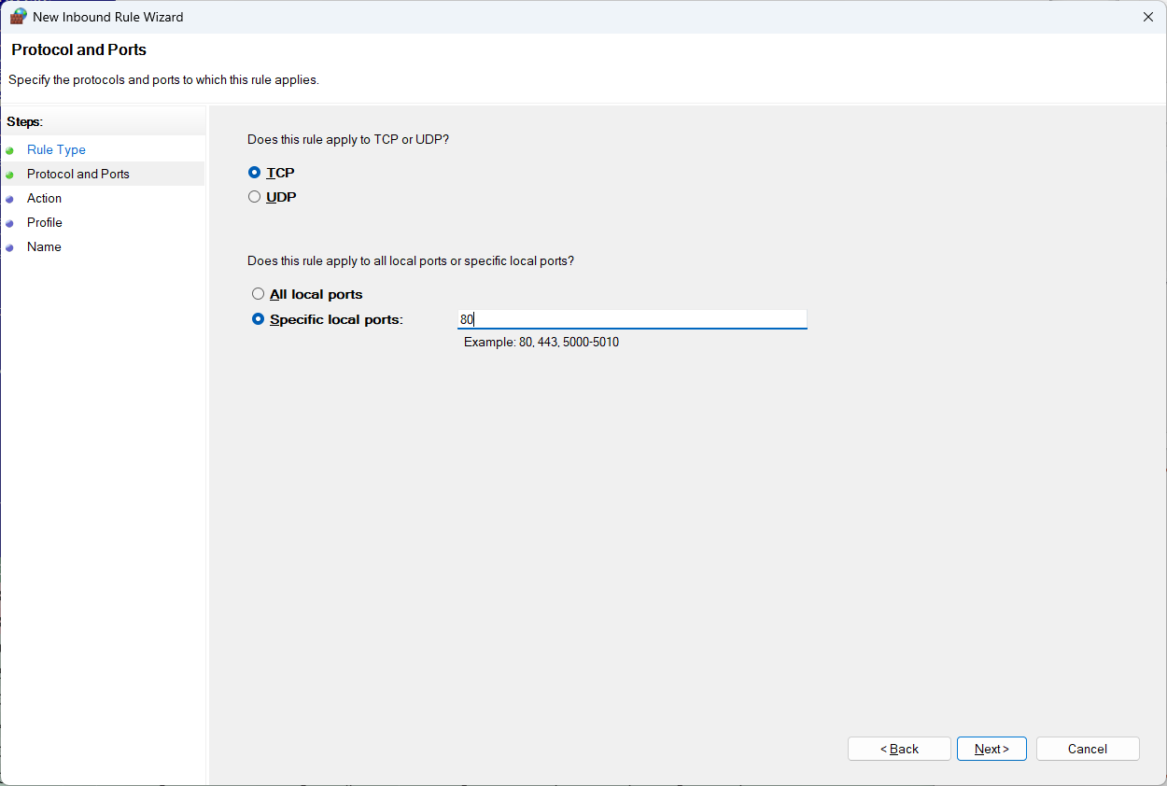
Windows Defender Firewall
5. The new rule will apply to TCP port 80 (the usual HTTP port).

Slide 26
Windows Defender Firewall
6. The new rule will apply to any TCP port 80 you specify.

Slide 27
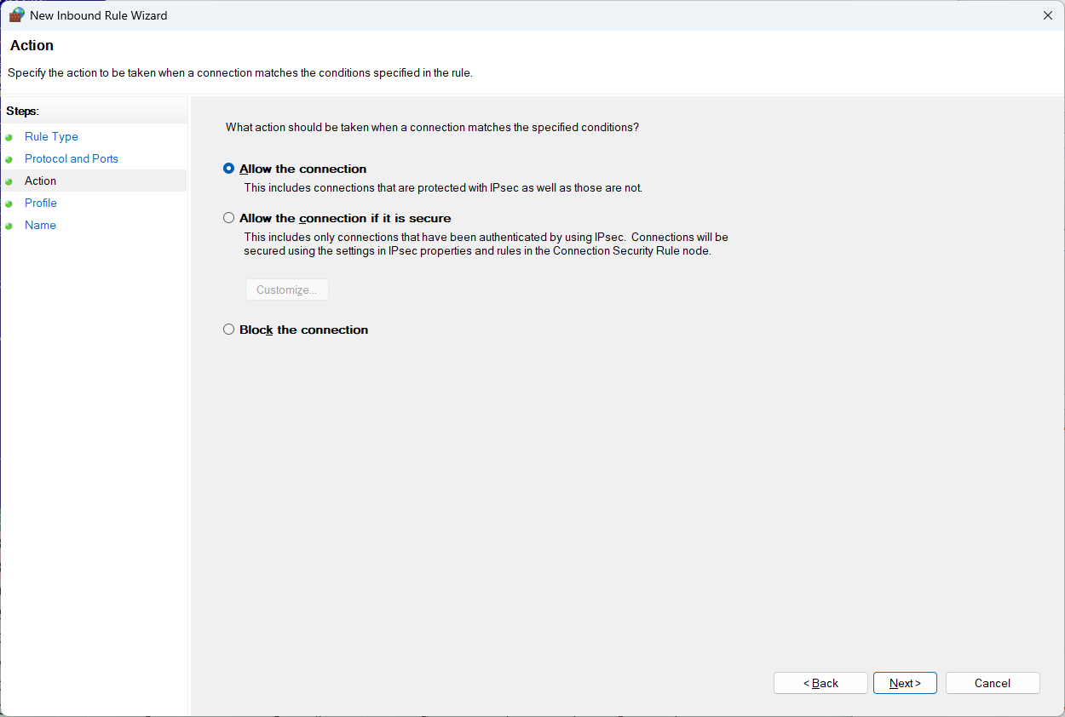
Windows Defender Firewall
7. Allow inbound connections to this port.

Slide 28
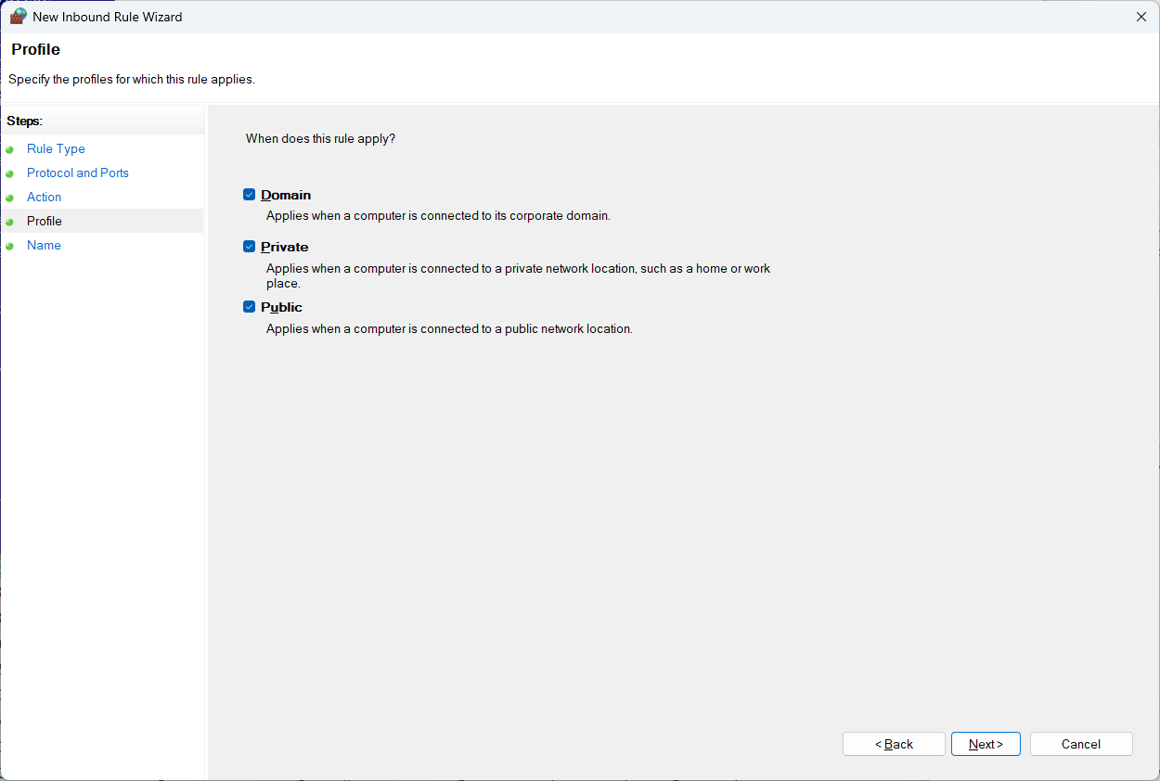
Windows Defender Firewall
8. Applies anywhere.

Slide 29
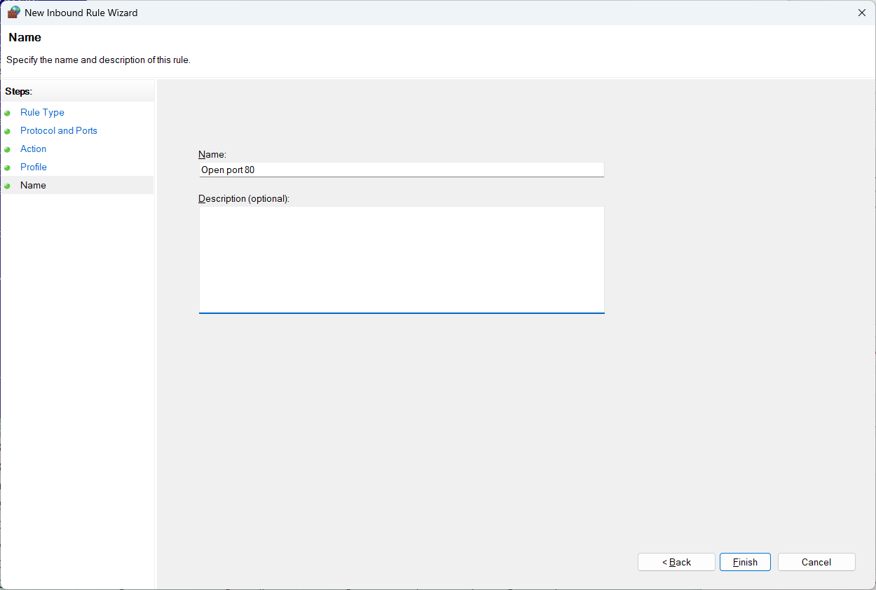
Windows Defender Firewall
9. Give it a name and click Finish.

Slide 30
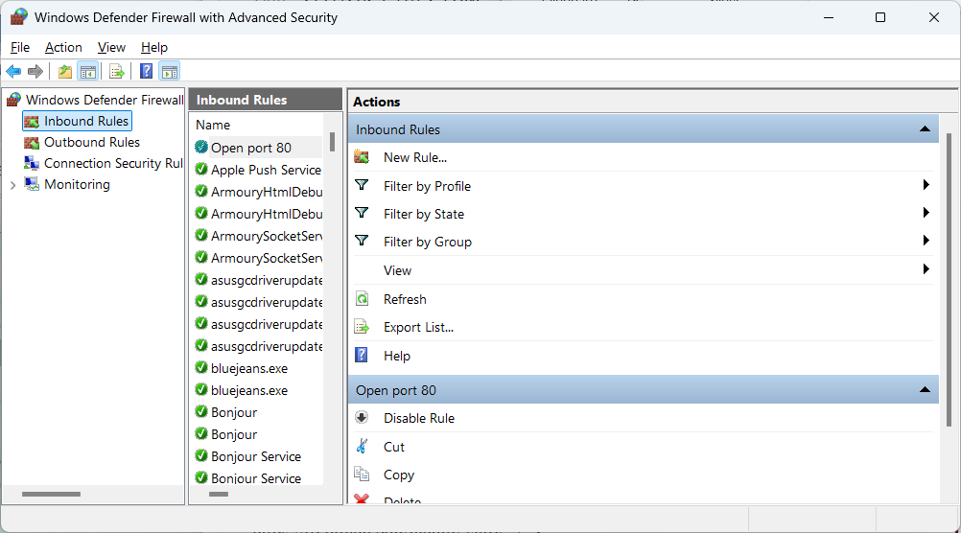
Windows Defender Firewall
10. Now have a new rule opening port 80 to Windows applications.

Slide 31
opening a port to WSL2
Two steps:
Open the port in the Windows Defender Firewall to Windows applications.
Set the networking mode in WSL2 to mirrored, meaning the network interfaces available in Windows are mirrored in WSL2.

Slide 32
~/.wslconfig
Create a ~/.wslconfig file with this content to allow WSL2 apps to access the Windows network interfaces.
[wsl2]
networkingMode=mirrored

Slide 33
privileged ports
In all Linux systems, ports numbered 1023 and below are privileged ports.
Only processes running with root privileges (superuser access) can bind to these ports.
Ensures that if you connect to a standard service like HTTP (port 80) or HTTPS (port 443), you can be reasonably confident you are communicating with the legitimate, system-controlled application, and not a malicious program set up by an unprivileged user.

Slide 34
agenda
details
HTTP redirects
LinuxTinyServer
opening a port to WSL2
bind( ), listen( ) and accept( )
the Talk( ) thread
a plugin interface
forms

Slide 35
bind( ), listen( ) and accept( )
The basic steps to a web server:
Creates two socket variables, one for listening, the other when a new client connects.
Build a sockaddr_in structure specifying internet protocol, port number, any IP address, TCP stream.
Binds the socket to that address.
Enters a loop where it begins listening.
Each time it gets a connection request, it spawns a thread to talk to the client.

Slide 36
bind( )
bind( ) is used to connect a socket to a particular address, protocol and port where it can listen.
#include <sys/types.h>
#include <sys/socket.h>
int bind(int sockfd, const struct sockaddr *addr,
socklen_t addrlen);

Slide 37
bind( )
bind( ) is used to connect a socket to a particular address, protocol and port where it can listen.
All of that is specified in an addrinfo structure.
#include <sys/types.h>
#include <sys/socket.h>
int bind(int sockfd, const struct sockaddr *addr,
socklen_t addrlen);
struct addrinfo {
int ai_flags;
int ai_family;
int ai_socktype;
int ai_protocol;
socklen_t ai_addrlen;
struct sockaddr *ai_addr;
char *ai_canonname;
struct addrinfo *ai_next;
};

Slide 38
listen( )
listen( ) marks the socket as one to be used for accepting incoming connection requests.
The backlog is the maximum queue length of pending connections.
#include <sys/types.h>
#include <sys/socket.h>
int listen(int sockfd, int backlog);

Slide 39
listen( )
listen( ) marks the socket as one to be used for accepting incoming connection requests.
The backlog is the maximum queue length of pending connections.
#include <sys/types.h>
#include <sys/socket.h>
int listen(int sockfd, int backlog);
SOMAXCONN is a system-configured default maximum socket queue length.
(Under WSL Ubuntu, it's defined as 128 in /usr/include/x86_64-linux-gnu/bits/socket.h.)

Slide 40
listen( )
Any client anywhere on the web that has your IP and port address can try to connect to you.
#include <sys/types.h>
#include <sys/socket.h>
int listen(int sockfd, int backlog);
SOMAXCONN is a system-configured default maximum socket queue length.
(Under WSL Ubuntu, it's defined as 128 in /usr/include/x86_64-linux-gnu/bits/socket.h.)

Slide 41
accept( )
accept( ) waits until a client tries to do a connect( ) and then returns a new socket file descriptor for talking to the client.
The sockaddr that’s returns tells you the client’s IP address.
#include <sys/types.h>
#include <sys/socket.h>
int accept(int sockfd, struct sockaddr *addr,
socklen_t *addrlen);

Slide 42
int main( int argc, char **argv )
{
// Check usage and arguments.
// Create two sockets, one for listening for new
// connection requests, the other for talking to each
// new client.
// Create socket address structures to go with each
// socket, filling in details of where we'll listen.
// Create the listenSocket, specifying that we'll r/w
// it as a stream of bytes using TCP/IP.
// Bind the listen socket to the IP address and protocol
// where we'd like to listen for connections.
// Begin listening for clients to connect to us.
// Accept each new connection and create a thread to talk with
// the client over the new talk socket that's created by Linux
// when we accept the connection.
// Close the listen socket.
}

Slide 43
passing the talk socket to the child
When creating a child thread, you get to pass a void *, usually a pointer to an object with whatever information the child needs.
Since the server expects to get lots of connection requests, it can’t pass a pointer to a local or global variable that will quickly be overwritten.
Solution is to pass a pointer to an object on the heap and let the child delete it.
while ( ( talkAddressLength = sizeof( talkAddress ),
talkSocket = accept( ... ) ) && talkSocket != -1 )
{
pthread_t child;
pthread_create( &child, nullptr, Talk,
new int( talkSocket ) );
pthread_detach( child );
}

Slide 44
agenda
details
LinuxTinyServer
opening ports to WSL2
bind( ), listen( ) and accept( )
the Talk( ) thread
a plugin interface
forms

Slide 45
the talk thread
The Talk thread looks for a GET message and replies with the requested file.
But it also has a plugin interface that allows a server application to intercept “magic paths”.
void *Talk( void *talkSocket )
{
// Cast from void * to int * to recover the talk
// socket id then delete the copy passed on the heap.
// Allocate a buffer for reading the incoming
// request and for reading the requested file.
// Do a recv( ) to get the request.
// Parse the request to find the action and path
// being requested.
// Watch for a plugin that intercepts this path.
// If it's a GET and the path is found in the website
// directory, return it with an HTTP/1.1 200 OK
// message, otherwise with a 403 or 404.
// Close the talk socket.
}

Slide 46
the talk thread
It can’t just paste the requested path onto the end of the website directory path.
Must watch for “..” segments and forbid access outside the website.
void *Talk( void *talkSocket )
{
// Cast from void * to int * to recover the talk
// socket id then delete the copy passed on the heap.
// Allocate a buffer for reading the incoming
// request and for reading the requested file.
// Do a recv( ) to get the request.
// Parse the request to find the action and path
// being requested.
// Watch for a plugin that intercepts this path.
// If it's a GET and the path is found in the website
// directory, return it with an HTTP/1.1 200 OK
// message, otherwise with a 403 or 404.
// Close the talk socket.
}

Slide 47
agenda
details
LinuxTinyServer
opening ports to WSL2
bind( ), listen( ) and accept( )
the Talk( ) thread
a plugin interface
forms

Slide 48
the talk thread
The Talk thread looks for a GET message and replies with the requested file.
But it also has a plugin interface that allows a server application to intercept “magic paths”.
void *Talk( void *talkSocket )
{
// Cast from void * to int * to recover the talk
// socket id then delete the copy passed on the heap.
// Allocate a buffer for reading the incoming
// request and for reading the requested file.
// Do a recv( ) to get the request.
// Parse the request to find the action and path
// being requested.
// Watch for a plugin that intercepts this path.
// If it's a GET and the path is found in the website
// directory, return it with an HTTP/1.1 200 OK
// message, otherwise with a 403 or 404.
// Close the talk socket.
}

Slide 49
the plugin object
A plugin inherits from this in plugin.h.
class PluginObject
{
public:
// MagicPath returns true if this is a path
// the plugin intercepts.
virtual bool MagicPath( string path ) = 0;
// The request passed to ProcessRequest is
// the raw contents of the HTTP request as
// read from the talk socket.
// Whatever is returned is written unchanged
// to the socket (and to the client) with a
// proper HTTP header.
string ProcessRequest( string request ) = 0;
virtual ~PluginObject( )
{
}
};

Slide 50
the plugin interface
The plugin registers itself by setting a global pointer.
The initial value is null.
// The constructor for any plugin should set
// Plugin = this so that LinuxTinyServer knows
// it exists and can call it.
#include "Plugin.h"
PluginObject *Plugin = nullptr;

Slide 51
the plugin interface
Here’s how LinuxTinyServer checks for a plugin and whether it’s a magic path.
If it’s magic, let the plugin process the request and return whatever it responds.
// Check to see if there's a plugin and, if there is,
// whether this is a magic path intercepted by the plugin.
if ( Plugin && Plugin->MagicPath( r.Path ) )
{
string request( buffer, bytes );
string response = Plugin->ProcessRequest( request );
cout << response << endl;
send( ts, response.c_str( ), response.size( ), 0 );
close( ts );
return nullptr;
}

Slide 52
agenda
details
LinuxTinyServer
opening ports to WSL2
bind( ), listen( ) and accept( )
the Talk( ) thread
a plugin interface
forms

Slide 53
forms
Several ways of doing this.
GET
POST
REST using JSON

Slide 54
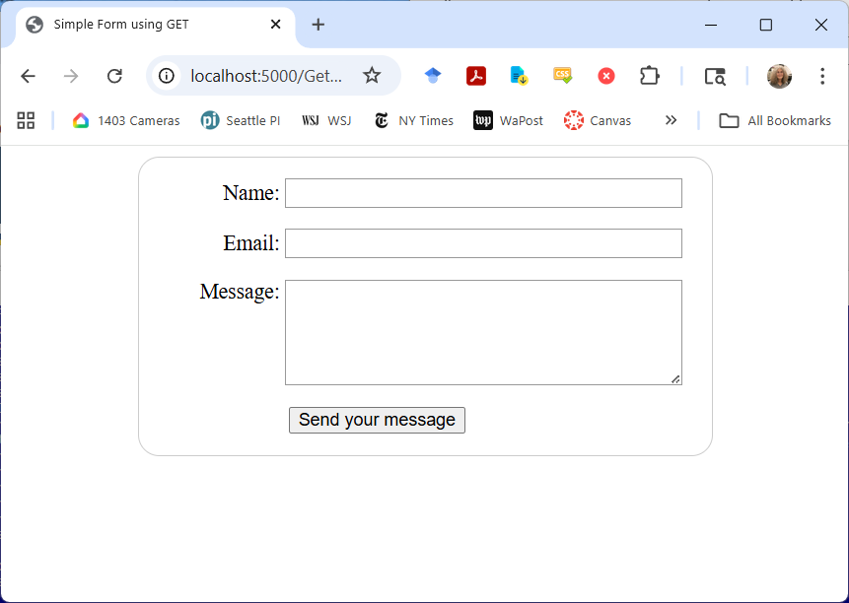
<!DOCTYPE html>
<html>
<head>
<title>Simple Form using GET/title>
<link href="SimpleForm.css" rel="stylesheet">
</head>
<body>
<form action="/GetForm.htm" method="get">
<div>
<label for="name">Name:</label>
<input type="text" id="name" name="user_name" />
</div>
<div>
<label for="mail">Email:</label>
<input type="email" id="mail" name="user_email" />
</div>
<div>
<label for="msg">Message:</label>
<textarea id="msg" name="user_message"></textarea>
</div>
<div class="button">
<button type="submit">Send your message</button>
</div>
</form>
</body>
</html>

Slide 55
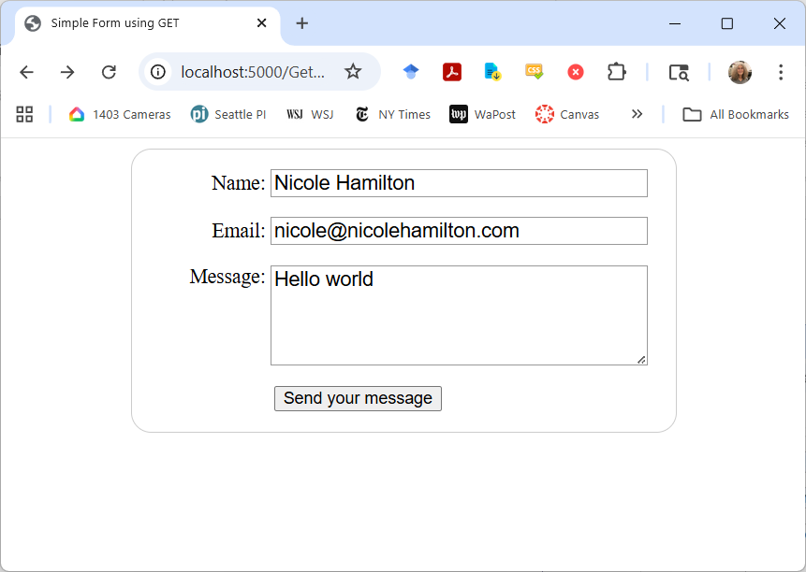
Typing this and pressing Send sends a GET message to the server with the form information passed as ? query string.
http://localhost:5000/GetForm.htm?user_name=Nicole+Hamilton&user_email=nicole%40nicolehamilton.com&user_message=Hello+world

Slide 56
LinuxTinyServer sees this.
GET /GetForm.htm?user_name=Nicole+Hamilton&user_email=nicole%40nicoleh
amilton.com&user_message=Hello+world HTTP/1.1
Host: localhost:5000
Connection: keep-alive
:
User-Agent: Mozilla/5.0 (Windows NT 10.0; Win64; x64) AppleWebKit/537.36 (KHTML, like Gecko) Chrome/139.0.0.0 Safari/537.36
Accept: text/html,application/xhtml+xml,application/xml;q=0.9,image/avif,image/webp,image/apng,*/*;q=0.8,application/signed-exchange;v=b3;q=0.7
:
Referer: http://localhost:5000/GetForm.htm
Accept-Encoding: gzip, deflate, br, zstd
Accept-Language: en-US,en;q=0.9

Slide 57
Since that’s not a filename and I haven’t defined a plugin, it fails as a 404.
Path does not exist.
HTTP/1.1 404 Not Found
Content-Length: 0
Connection: close
But obviously, we could intercept that and make it do something useful.

Slide 58
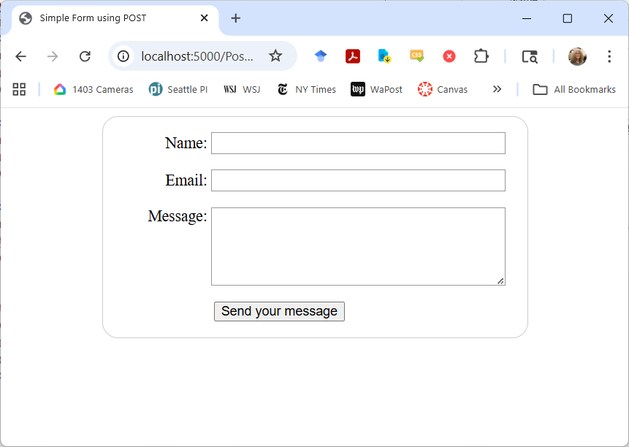
<!DOCTYPE html>
<html>
<head>
<title>Simple Form using POST</title>
<link href="SimpleForm.css" rel="stylesheet">
</head>
<body>
<form action="/PostForm.htm" method="post">
<div>
<label for="name">Name:</label>
<input type="text" id="name" name="user_name" />
</div>
<div>
<label for="mail">Email:</label>
<input type="email" id="mail" name="user_email" />
</div>
<div>
<label for="msg">Message:</label>
<textarea id="msg" name="user_message"></textarea>
</div>
<div class="button">
<button type="submit">Send your message</button>
</div>
</form>
</body>
</html>

Slide 59
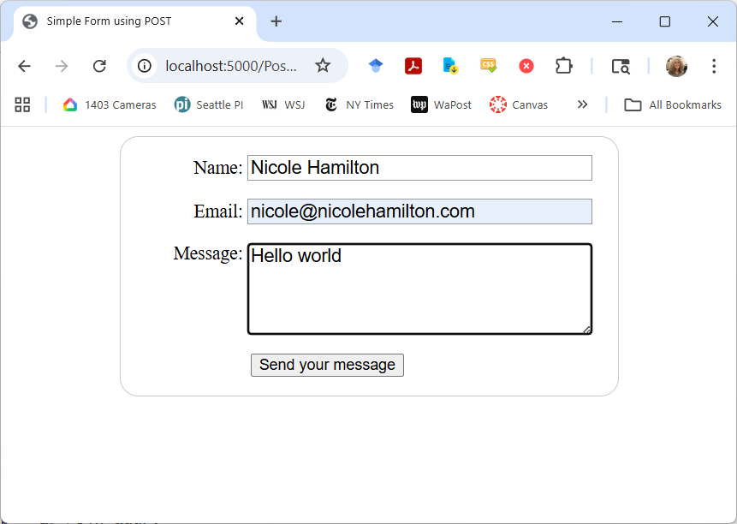
Typing this and pressing Send sends a POST message to the server with the form information passed as content.
The URL is unchanged.

Slide 60
LinuxTinyServer sees this.
POST /PostForm.htm HTTP/1.1
Host: localhost:5000
Connection: keep-alive
Content-Length: 89
:
Origin: http://localhost:5000
Content-Type: application/x-www-form-urlencoded
Upgrade-Insecure-Requests: 1
User-Agent: Mozilla/5.0 (Windows NT 10.0; Win64; x64) AppleWebKit/537.36 (KHTML, like Gecko) Chrome/139.0.0.0 Safari/537.36
Accept: text/html,application/xhtml+xml,application/xml;q=0.9,image/avif,image/webp,image/apng,*/*;q=0.8,application/signed-exchange;v=b3;q=0.7
:
Referer: http://localhost:5000/PostForm.htm
Accept-Encoding: gzip, deflate, br, zstd
Accept-Language: en-US,en;q=0.9
user_name=Nicole+Hamilton&user_email=nicole%40nicolehamilton.com&user_message=Hello+world

Slide 61
It doesn’t understand POST and I haven’t defined a plugin, it also fails.
Path does not exist.
HTTP/1.1 404 Not Found
Content-Length: 0
Connection: close
But obviously, we could intercept this also and make it do something useful.

Slide 62
280 OfficeHours example
Example: The 280 Office Hours project.
The plugin constructor registers itself by setting the global pointer.
class P4_Web : public PluginObject
{
public:
bool MagicPath( const string path )
{
// Return true if this is a path that
// this plugin intercepts.
}
string ProcessRequest( const string request )
{
// Read the request and return a string
// with the proper HTTP header and content.
}
P4_Web( )
{
// Register this plugin.
Plugin = this;
}
~P4_Web( )
{
}
};
https://eecs280staff.github.io/p4-web/

Slide 63
280 OfficeHours example
A Javascript script communicates with the host by using GET, POST, and DELETE requests.
Data is passed in JSON format.
class P4_Web : public PluginObject
{
public:
bool MagicPath( const string path )
{
// Return true if this is a path that
// this plugin intercepts.
}
string ProcessRequest( const string request )
{
// Read the request and return a string
// with the proper HTTP header and content.
}
P4_Web( )
{
// Register this plugin.
Plugin = this;
}
~P4_Web( )
{
}
};

Slide 64
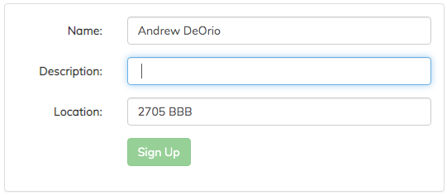
The HTML form has named elements that can be accessed from Javascript.
When you enter data, that’s POST’ed to the host as JSON.
Browser sends:
POST /api/queue/tail/ HTTP/1.1
Host: localhost
Content-Type: application/json; charset=utf-8
Content-Length: 59
{
"uniqname": "awdeorio",
"location": "2705 BBB"
}
Webserver responds:
HTTP/1.1 201 Created
Content-Type: application/json; charset=utf-8
Content-Length: 78
{
"location": "2705 BBB",
"position": 1,
"uniqname": "awdeorio"
}

